Slide 1
Course Syllabus: CIVE 497 – CIVE 700
Chul Min Yeum
Assistant Professor
Civil and Environmental Engineering
University of Waterloo, Canada
CIVE 497 – CIVE 700: Smart Structure Technology
Last updated: 2019-12-30

Slide 2
Course Description
This course offers an introduction to the emerging smart structure technologies in civil engineering. Smart structures integrate sensing, actuation, data processing and analysis, and control capabilities so that a structure can sense and respond to its changing external conditions in a rapid and automated manner. Among several topics in smart structure, this course focuses on structural assessment using optical sensor data by implementing state-of-art image processing and computer vision techniques. As a special topic, basic concepts in machine learning, neural networks, convolutional neural networks (deep learning) are covered and relevant applications in civil engineering are introduced. An application-based learning approach is emphasized and tasks are designed in such a way that students implement smart structure technology to address contemporary problems in civil engineering. In addition, one of the deliverable for this course will be a research project, in which student will have an opportunity to design a technique with a potential application to smart structures. This course is specially designed to suit the interest of graduate students and senior undergraduate students who may pursue graduate studies.
Notes:
This is not an introductory course.

Slide 3
Course Objectives
By the end of this course, students should be able to
Describe smart structure technology and its application in civil engineering
Explain the working principle of an accelerometer and digital camera, and their data acquisition process
Interpret the concept of image processing techniques through signal processing theory
Develop programs (MATLAB or Python) to process and analyze 2D and 3D optical data for structural assessment
Demonstrate how to implement machine learning algorithms in solving real-world problems
Employ deep convolutional neural network for image classification
Devise innovative smart structure technology for civil engineering applications and research

Slide 4
Course in W19
Based on the feedback received from the course in 2019 (six undergraduate and seven graduate students registered the course), you are expected to spend extra 12 hours or more week studying class materials as well as working on task assignments and research project. You will see the course outline and task assignments in W19.

Slide 5
Prerequisite
This course requires basic knowledge in linear algebra, probability, and signal processing and skills at a sufficient level of a non-trivial computer programming (with MATLAB or Python). Students also need to know how to use Markdown.
Matlab or Python
Markdown editor
Github
Matlab live editor
Power points

Slide 6
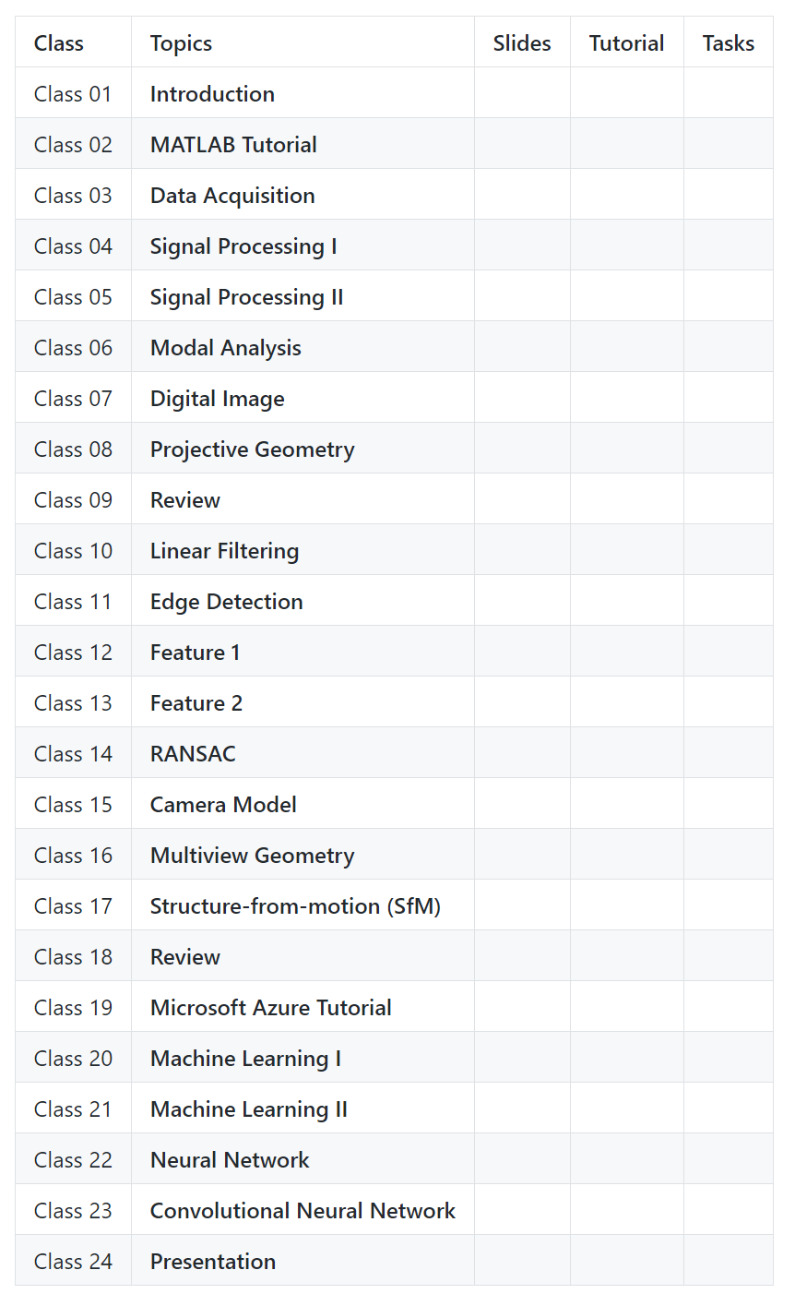
Course Outline
Introduction
Signal Processing
Image Processing
3D Data Processing
Machine Learning
Notes:
What do we need?

Slide 7
Tasks
There will be 7-9 tasks and posted on either weekly or biweekly on this course website. The instructor encourage students to work in groups through collaborative learning, but to submit their assignments individually. The task will have programming components or photography components, where students will use their own camera to capture and process their own images and discuss the results. Students are supposed to complete all tasks and turn their works in by the due date. After the due data, there is 25% deduction in the final mark and students must submit their works within a week after the due data. After then, the submission of the works will not be accepted unless accompanied by a valid excuse and some additional points might be deducted depending upon the circumstances.

Slide 8
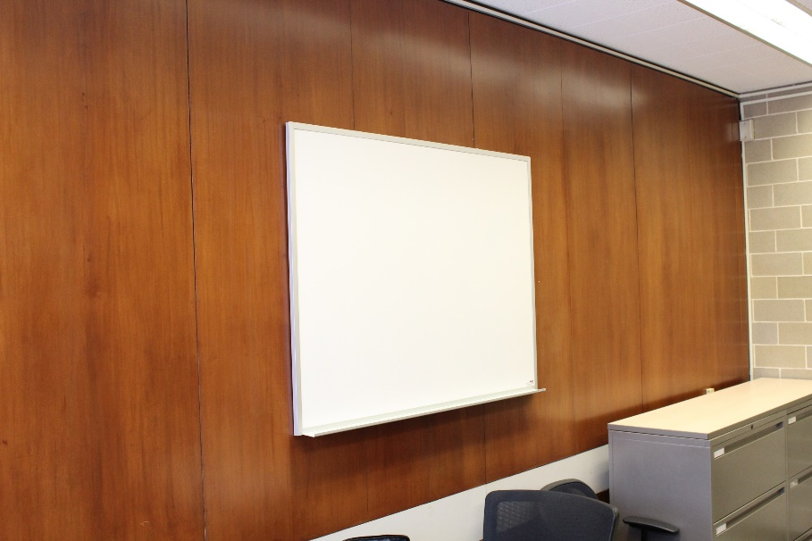
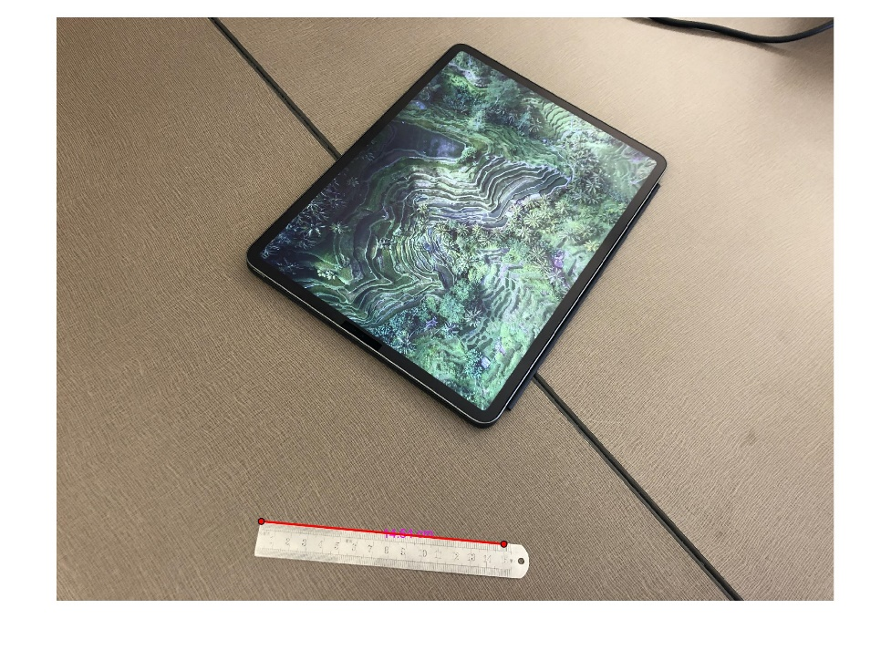
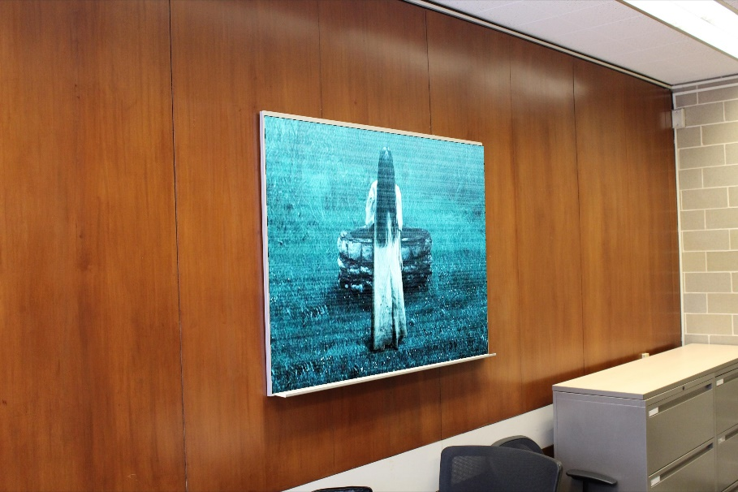
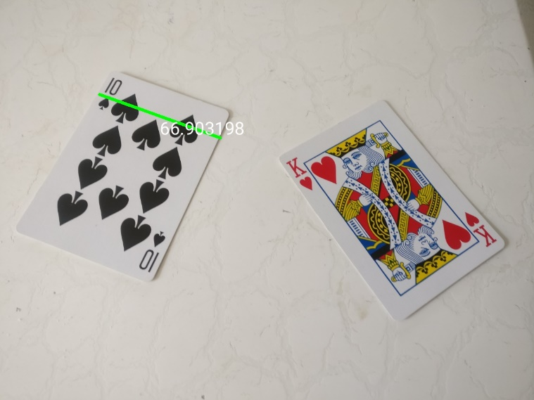
Tasks in W19
Hanging a nice picture
Image-based measurement

Slide 9
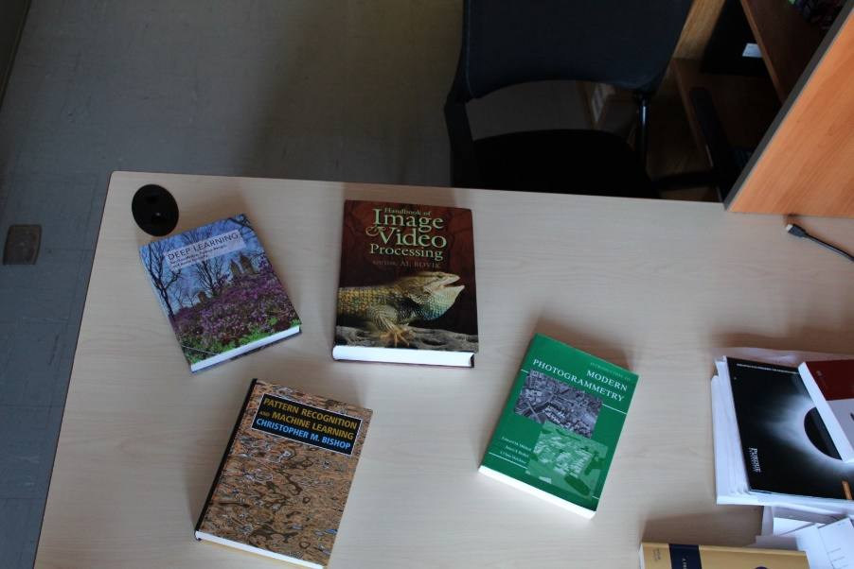
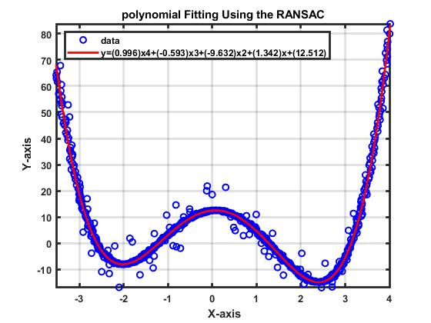
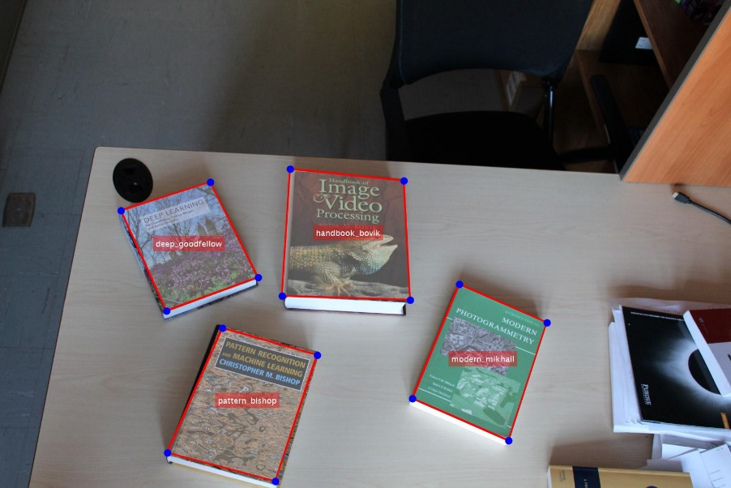
Tasks in W19 (Continue)
Polynomial fitting
Book detection

Slide 10
Class Tips
You can allow to bring your laptop into the class but should not do homework during class!
Ask as many questions as you can through the course website.
Must submit the task assignments (there is no default score).
Ask for help from the instructor and CA
Think about how to apply knowledge from the course to your research or job
Make friends who become your long-term research partners.

Slide 11
Project (for Graduate Students)
Students are encouraged to bring their own problems related to their thesis, research projects or potential research in civil engineering that they plan to pursue near future. This course gives special attention to exploring theory and potential techniques in the field of smart structure to address real problems that students are exposed to or involved in. Thus, students need to devise feasible project topics that are achievable within your current or future graduate study.
Tell us what you want to get from this course?

Slide 12
Grading
The final grade will be based on the total marks earned during the semester. Each task will be graded on the basis of 100 points and will contribute the final grade with different weights. The evaluation guideline for the project can be seen in the course website. Note that undergraduate and graduate students are marked using different evaluation metrics.
Undergraduate student: Task (100%) Graduate student: Task (70%) and Project (30%)

Slide 13
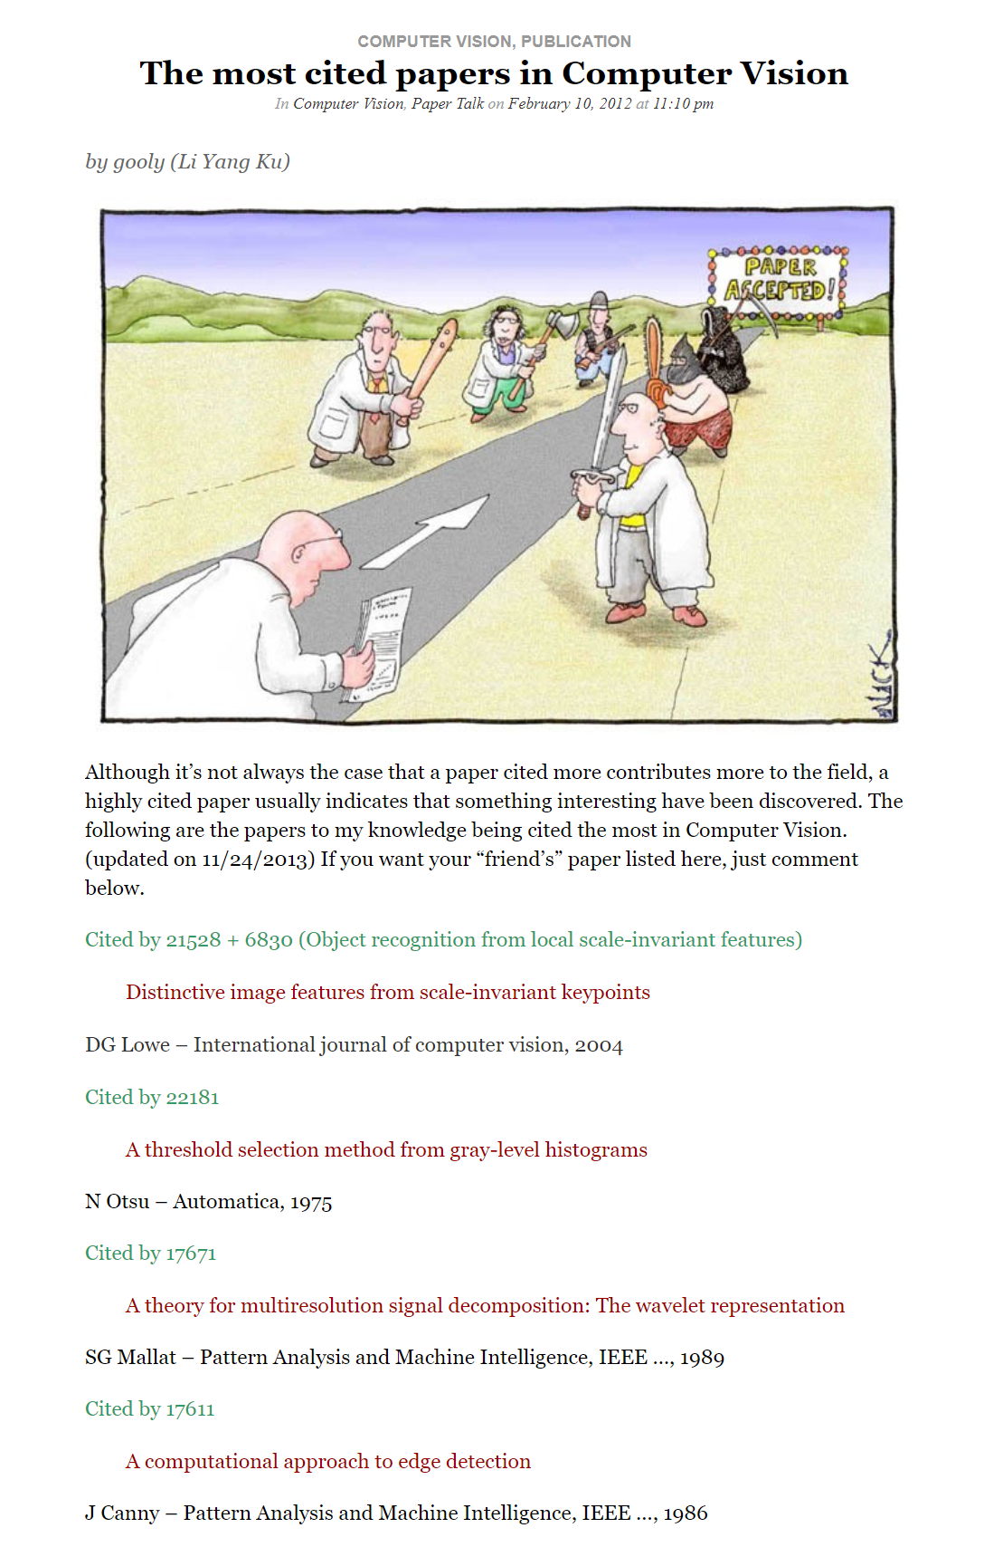
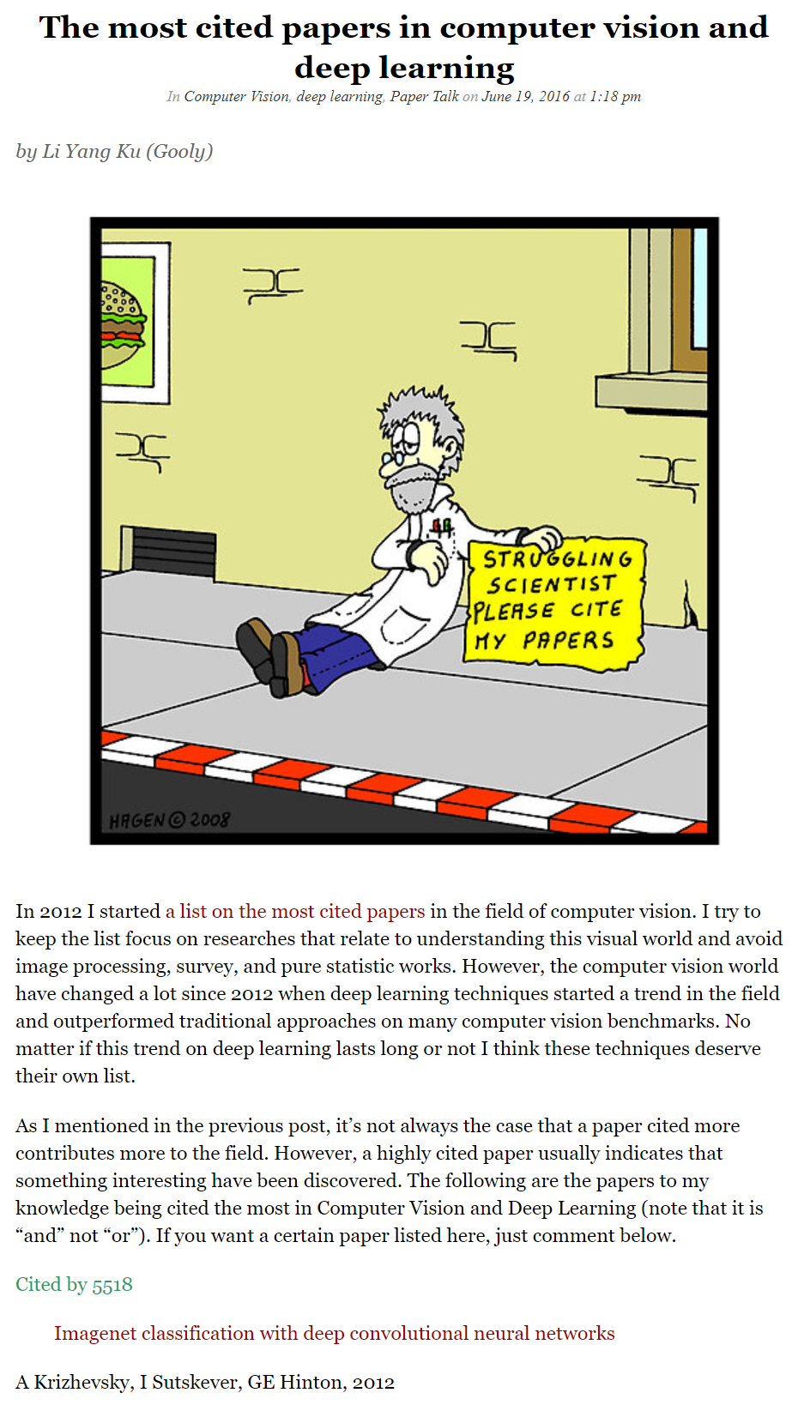
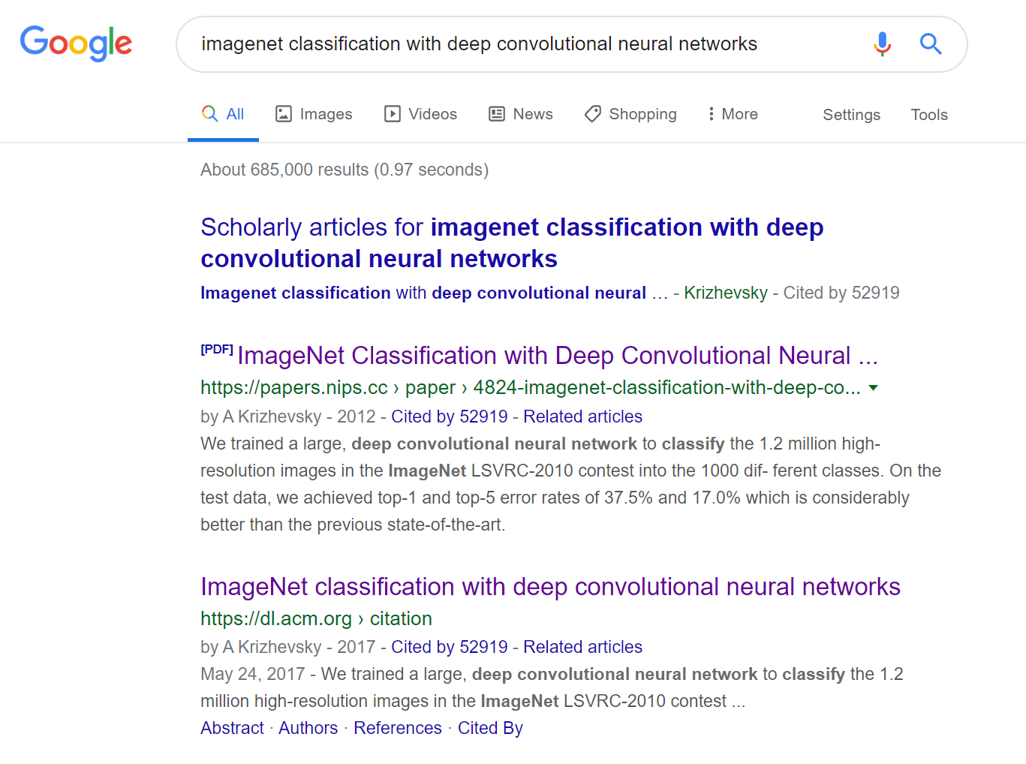
The Most Cited Papers in Computer Vision
https://computervisionblog.wordpress.com/2016/06/19/the-most-cited-papers-in-computer-vision-and-deep-learning/
https://computervisionblog.wordpress.com/2012/02/10/the-most-cited-papers-in-computer-vision/

Slide 14
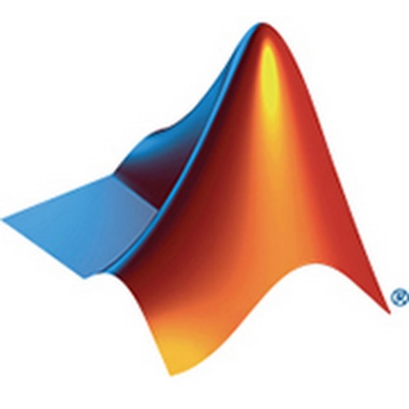
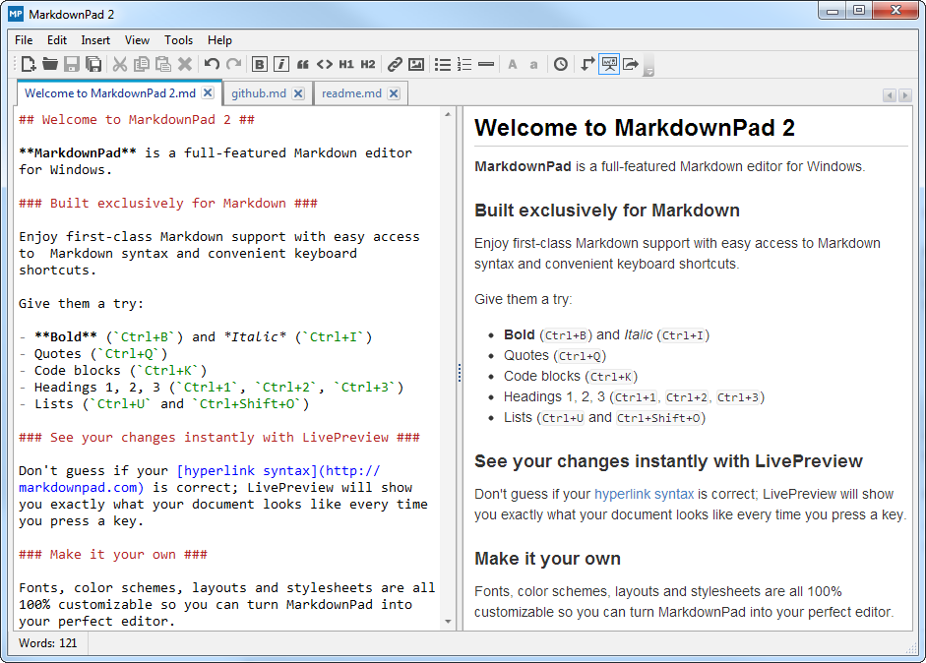
How To Use Tools
https://github.com/chulminy/AE121/tree/master/lab/lab01
https://github.com/chulminy/CIVE497-CIVE700/tree/master/tutorial/markdown

Slide 15

How To Use Tools (continue)
https://help.github.com/en/github/receiving-notifications-about-activity-on-github/watching-and-unwatching-releases-for-a-repository
https://www.youtube.com/watch?v=77W2JSL7-r8

Slide 16
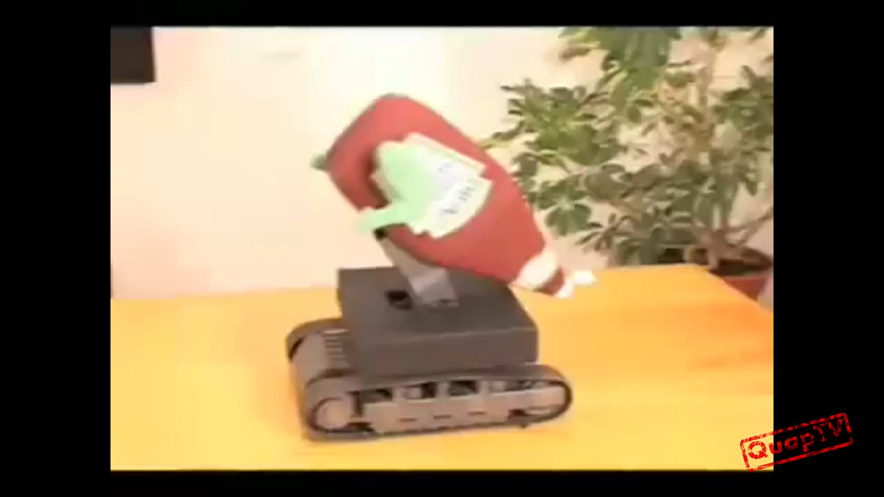
Remark
It is not that I’m so smart.
It is just that I stay with problems longer.
- Albert Einstein
https://www.youtube.com/watch?v=G2PJdmG2ICA

